Slide 1

Errors
Notes:
So, in this topic you are gonna get familiar with one of your best friends in IT world. yes i am talking about errors. you know what, most of programmers, including myself, face with errors when run our codes for the first time. this is very very normal. and be sure that these errors will guide you. and in this lesson i will try to show you how you can read, understand and manage errors

Slide 2
Table of Contents
Introduction to Errors
Syntax Errors
Common Errors
Notes:
at the end of this lesson you will be able to get familiar with common syntax errors and to handle with these errors.

Slide 3
Introduction to Errors
1

Slide 4
Introduction (review)
Consider the following example :
What is the output? Try to figure out in your mind...
Notes:
Sometimes you can see that the codes with the simplest syntax can give an error when you never expected.
print("Don't say 'I never make a mistake'"

Slide 5
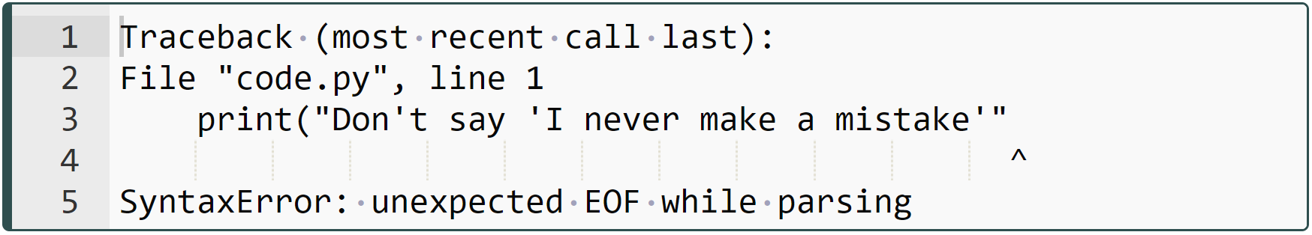
Introduction (review)
Consider the following example :
Notes:
In the error message appeared on the screen, there is the term Traceback.
It is actually a module of 622 lines of Python code.
This module provides a standard interface to extract, format and print stack traces of Python programs.
It exactly mimics the behavior of the Python interpreter when it prints a stack trace.
In this way, it allows you to follow the line and character of the error and trace it.

Slide 6
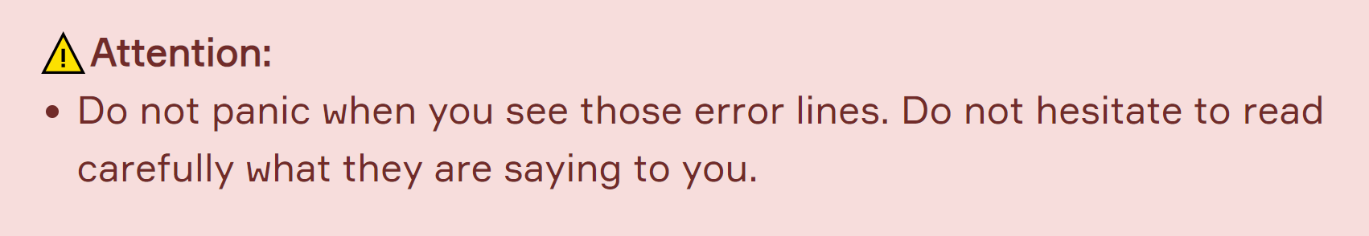
Introduction (review)
Notes:
The name of module - Traceback - appears when your code causes an error and it reports detailed information on that specific error, demonstrating the particular files in which the error occurred.
In this example, the last two lines indicate that this error type is a Syntax error and it also indicates in which line and in which character (with the ^ sign) the error raised.
dear friends, if you get error message do not panic. don’t hesitate to read carefully what they are saying to you.

Slide 7
Syntax Errors
2

Slide 8
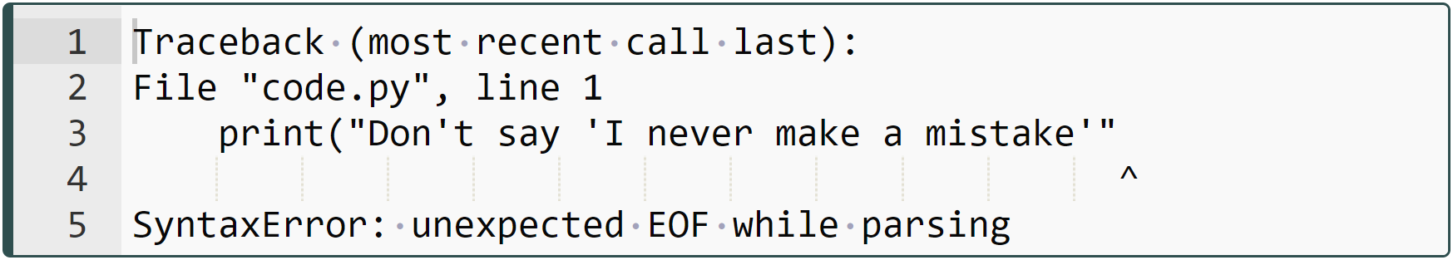
Syntax Errors (review)
) is forgotten
associated value
Notes:
Every syntax error has a text value (known as associated value) that describes the error in detail.
In this example, the message "SyntaxError: unexpected EOF while parsing" means that something else had been expected by the interpreter after your statement, but you didn't pass it to the interpreter.

Slide 9
Common Errors
3
Notes:
ok. from now on we will cover quickly some common errors we encounter in the real world.

Slide 10
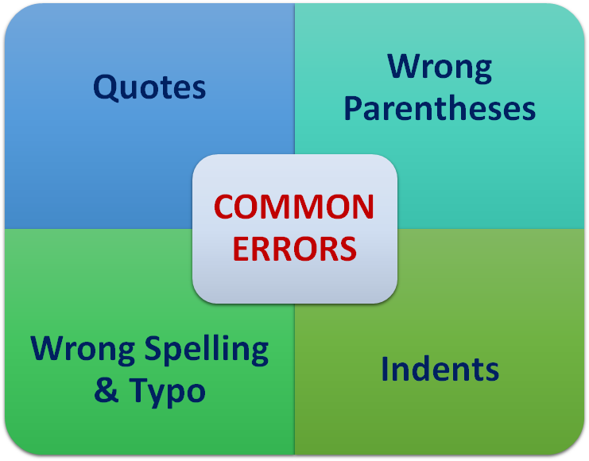
Common Errors (review)

Slide 11
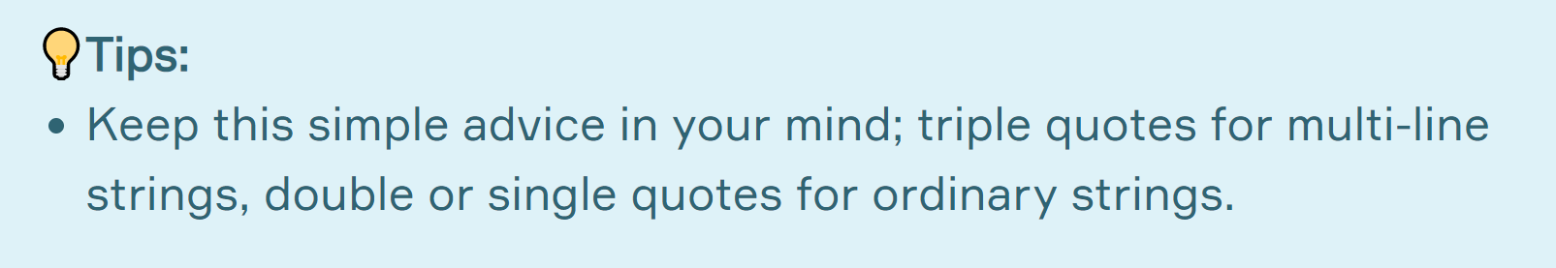
Common Errors (review)
Notes:
In the Matter of Quotes lesson, we have elaborated on how sensitive programming language Python is to quotation marks. So it's critical not to forget to enclose a string in quotes of the same type.

Slide 12
Common Errors (review)
Notes:
One of the most common syntax errors is the wrong number of parentheses in function calls. e.g. we should use parenthesis carefully and in a correct way. as many open parenthesis, the same number of closing parenthesis are required
== jupmp to colab ==
print(len(my_list[2:])

Slide 13
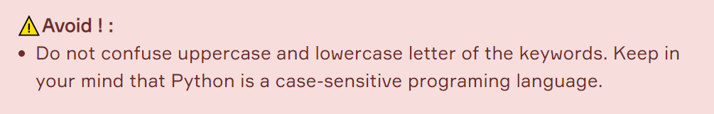
Common Errors (review)
Notes:
Yes, it may sound strange to you, but the most common mistake made by programmers is the wrong spelling keywords, function names, and variable names. e.g. True and true, print and prit or pirnt.

Slide 14
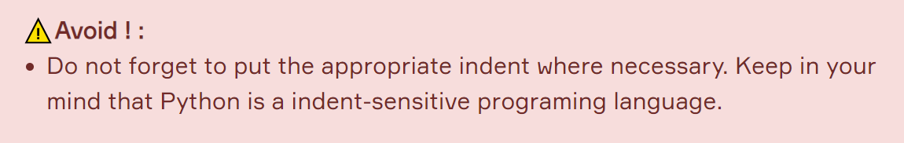
Common Errors (review)
Notes:
Indents are also very common errors for programmers. and you have already know that python is indents sensitive programming language as well as case sensitive programming language.

Slide 15
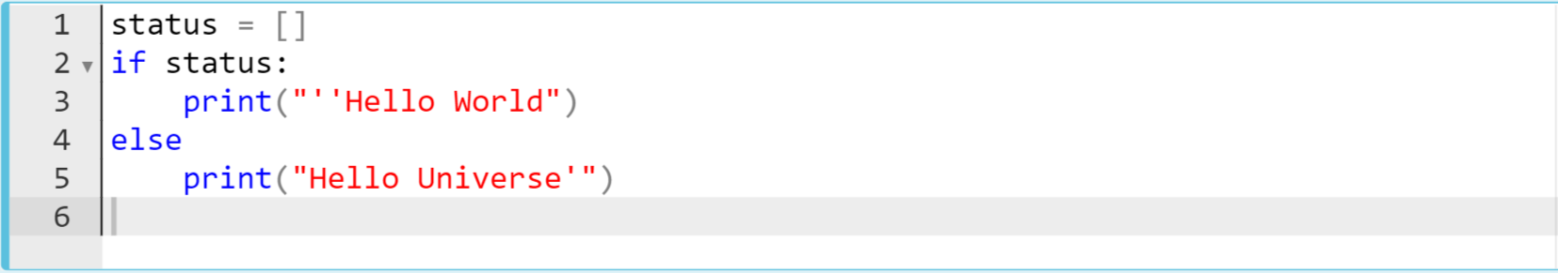
Common Errors
Let’s find some errors in the codes :
What is the error? Try to figure out in your mind...
Notes:
status = []
if status:
print("''HelloWorld")
else
print("Hello Universe'")

Slide 16
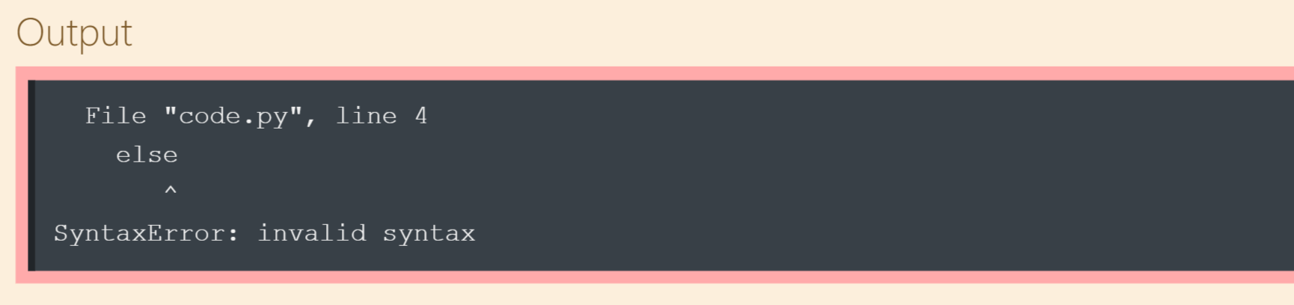
Common Errors
There is a typo (missing colon) :
a colon : should be put here
Notes:
status = []
if status:
print("''HelloWorld")
else
print("Hello Universe'")

Slide 17
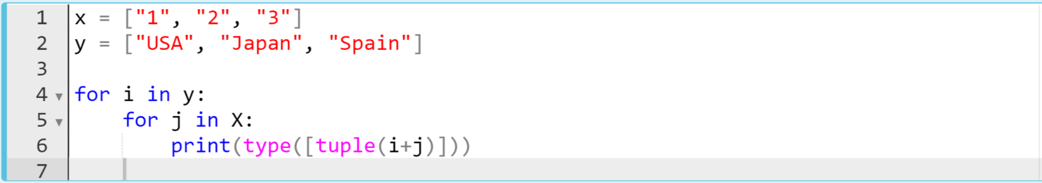
Common Errors
Let’s find some errors in the codes :
What is the error? Try to figure out in your mind...
Notes:
x = ["1", "2", "3"]
y = ["USA", "Japan", "Spain"]
for i in y:
for j in x:
print(type([tuple(i+j)]))

Slide 18
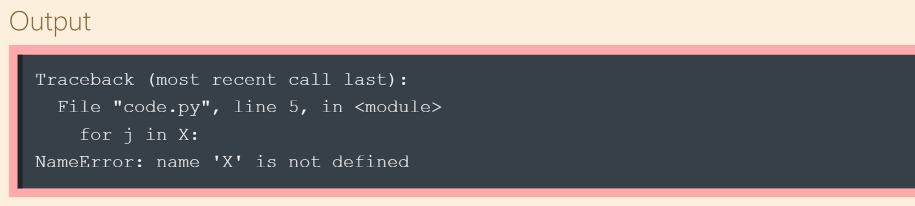
Common Errors
Remember, Python is a case-sensitive language :
case of "x" should be the same
case of "x" should be the same
Notes:
x = ["1", "2", "3"]
y = ["USA", "Japan", "Spain"]
for i in y:
for j in x:
print(type([tuple(i+j)]))

Slide 19
Exceptions
Notes:
yes
we have come closer to exception handling and before handling with it let’s get familiar with some kind of exception

Slide 20
Table of Contents
Introduction
Common Exceptions
Notes:
so at the end of this lesson you will be able to know the differences between exceptions and errors, moreover will be able to get familiar with common exceptions.

Slide 21
Introduction
1

Slide 22

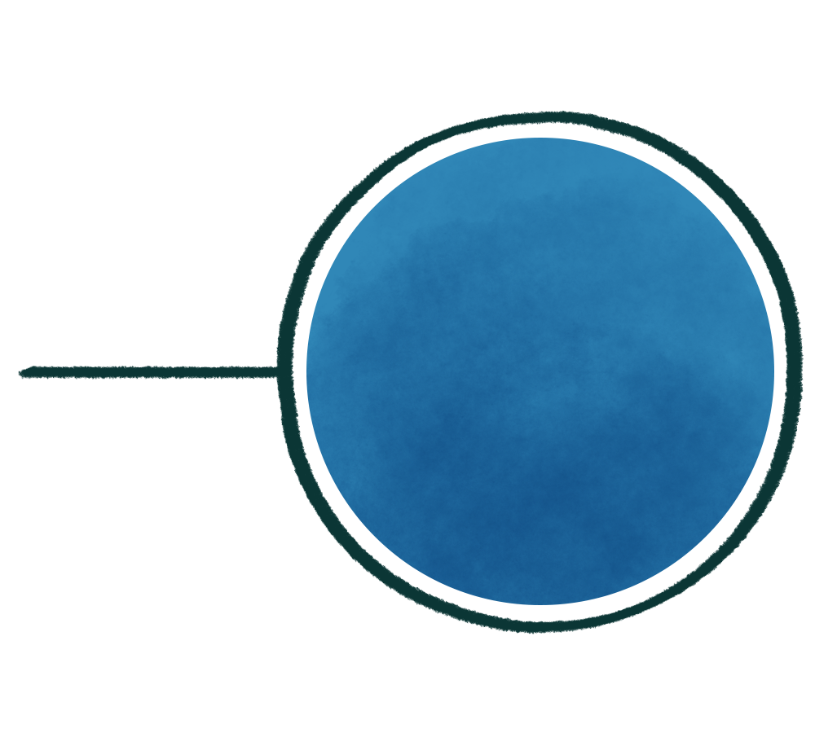
What is the difference?
Syntax Errors
What is the difference between these two types of errors?
Exception Errors

Slide 23
Introduction (review)
Syntax Error | Exception Error
These types of errors are detected during compiling the program into byte-code. | These types of errors are detected during the program execution (interpretation) process.
Notes:
If your program is running but you still get some error messages for several reasons, you probably get an error warning called an exception. This is because of defective line of codes in your program.
What is the difference between Syntax errors and Exception errors?

Slide 24
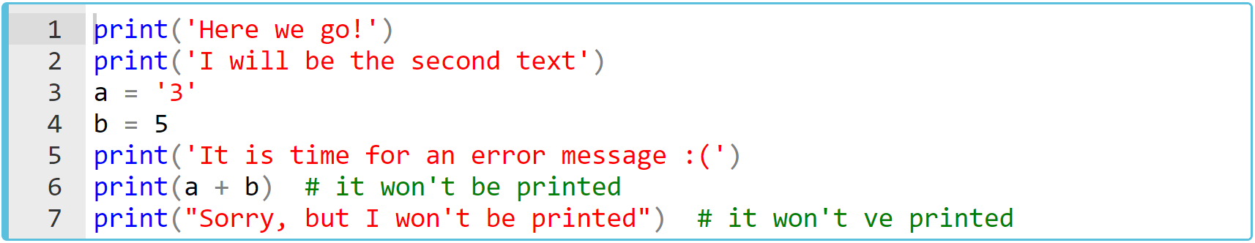
Introduction (review)
Now, let's examine the following example :
Notes:
print('Here we go!')
print('I will be the second text')
a = '3'
b = 5
print('It is time for an error message :(')
print(a + b) # it won't be printed
print("Sorry, but I won't be printed") # it won't be printed

Slide 25
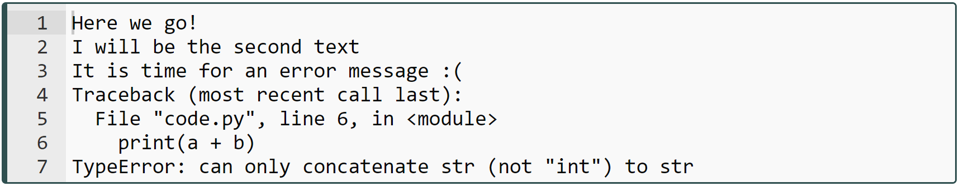
Introduction (review)
Now, let's examine the following example :
Notes:
yes, as you can see, the first three print() functions printed their own content, but the last two print() functions did not work and we received an exception error message. which means our program was partially executed. As i stated before, you should look at the last line of the error message which says that this is the TypeError. It's obvious, right? There is a wrong use of types of variables (a is a str type and b is an int).
print('Here we go!')
print('I will be the second text')
a = '3'
b = 5
print('It is time for an error message :(')
print(a + b) # it won't be printed
print("Sorry, but I won't be printed") # it won't be printed

Slide 26
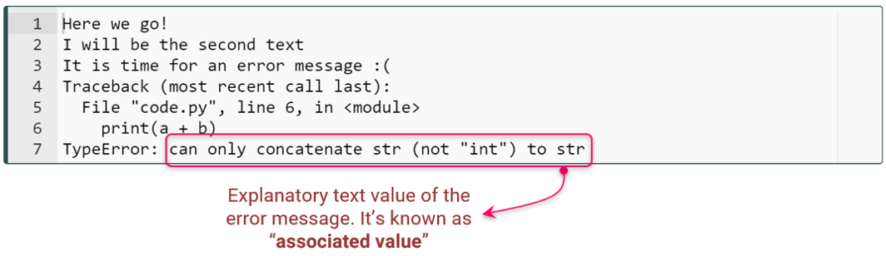
Introduction (review)
Exceptions also have explanatory “associated value” at the last line of the error message.
Notes:
Similar to the syntax errors, almost all exception error messages also have a text value which called “associated value” following the error message explaining what the error is related to.

Slide 27
Common Exceptions
2

Slide 28
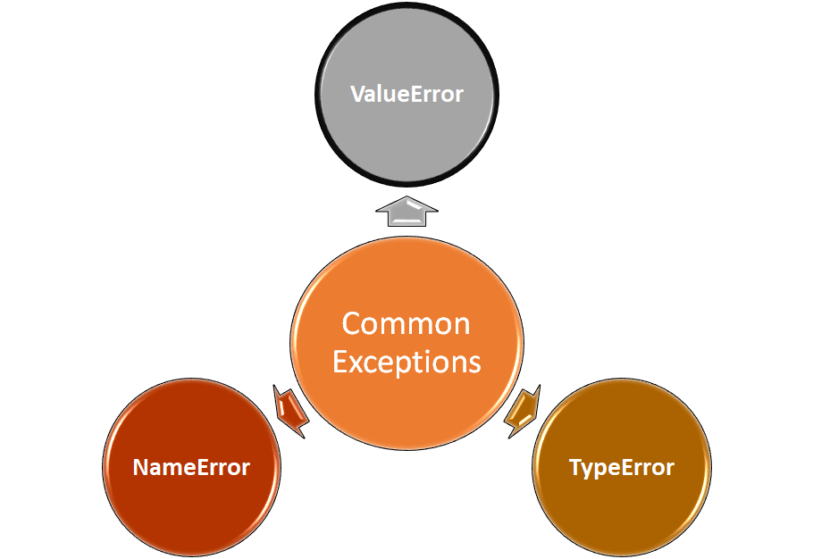
Common Exceptions (review)
ValueError
Notes:
-Raised when an operation or function receives an argument that has the right type but an inappropriate value, and the situation is not described by a more precise exception such as IndexError.
-In other words; to encounter a ValueError in Python means that it is a problem with the content of the object you tried to assign the value to. This should not be confused with types in Python. this is about the value of the data.

Slide 29
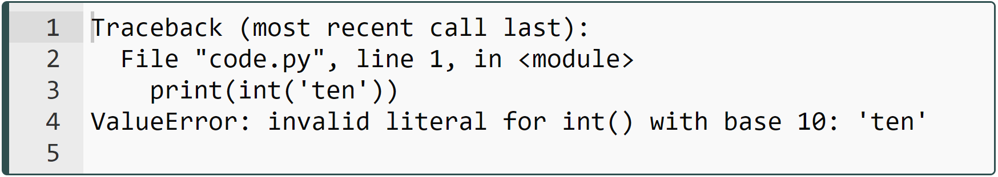
Common Exceptions (review)
ValueError
Notes:
print(int('ten'))

Slide 30
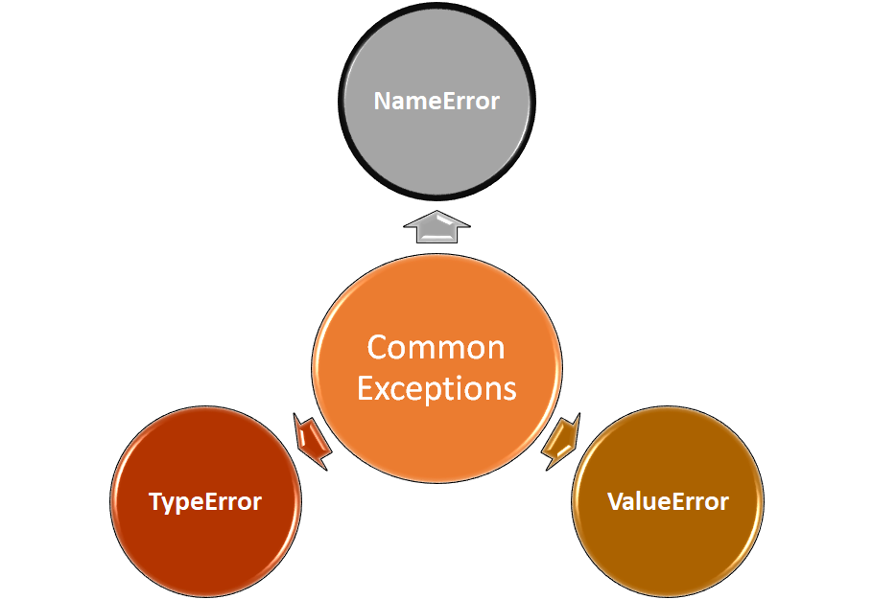
Common Exceptions (review)
NameError
Notes:
-This error is usually raised if a variable you use in the code stream is not pre-defined or not properly defined.
-In other words, it is raised when a local or global name is not found. This applies only to unqualified names.
-The associated value is an error message that includes the name that could not be found.

Slide 31
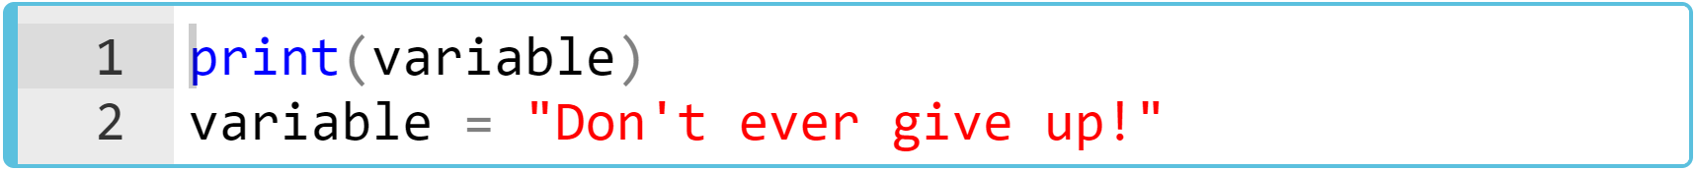
Common Exceptions (review)
NameError
Notes:
print(variable)
variable = "Don't ever give up!"

Slide 32
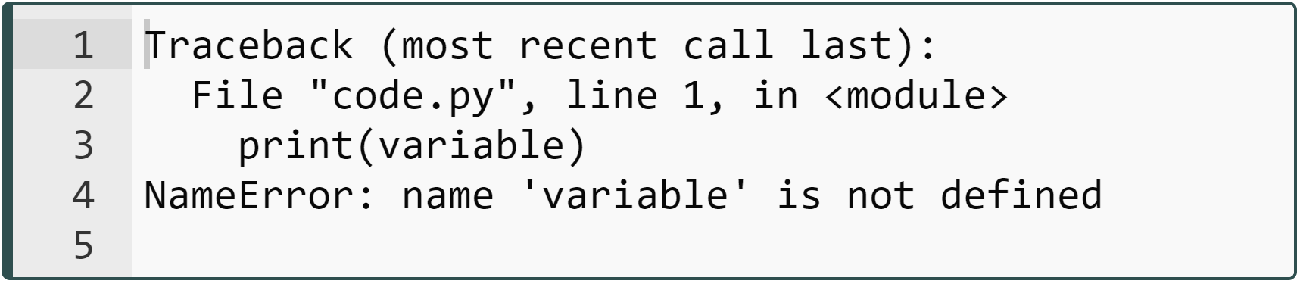
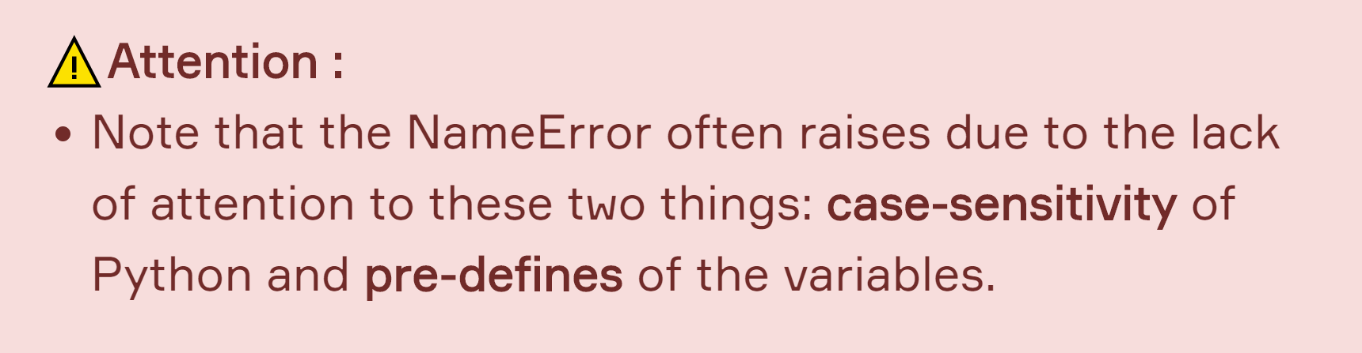
Common Exceptions (review)
NameError
Notes:
print(variable)
variable = "Don't ever give up!"

Slide 33
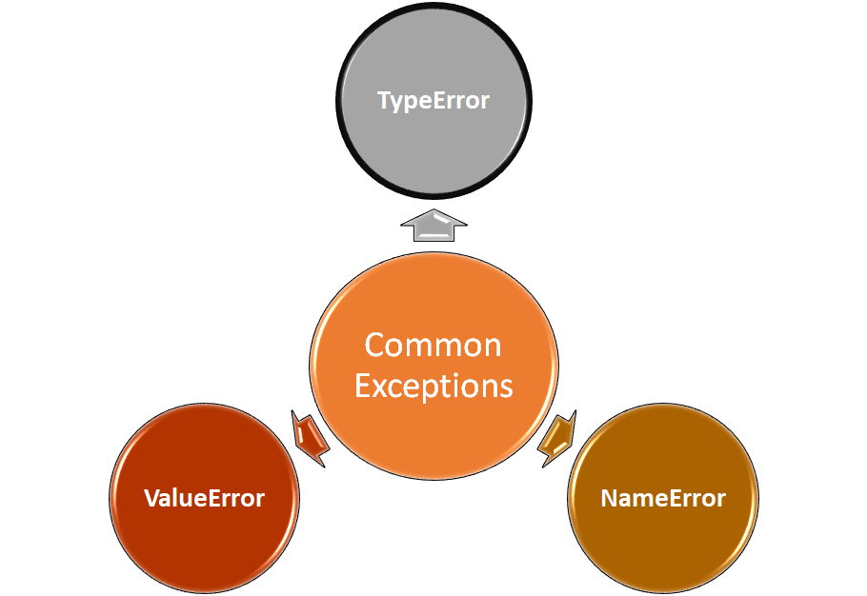
Common Exceptions (review)
TypeError
Notes:
-Raised when an operation or function is applied to an object of inappropriate type.
-The associated value is a string giving details about the type mismatch.

Slide 34
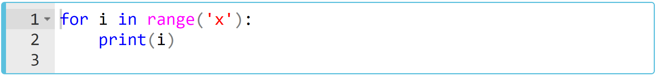
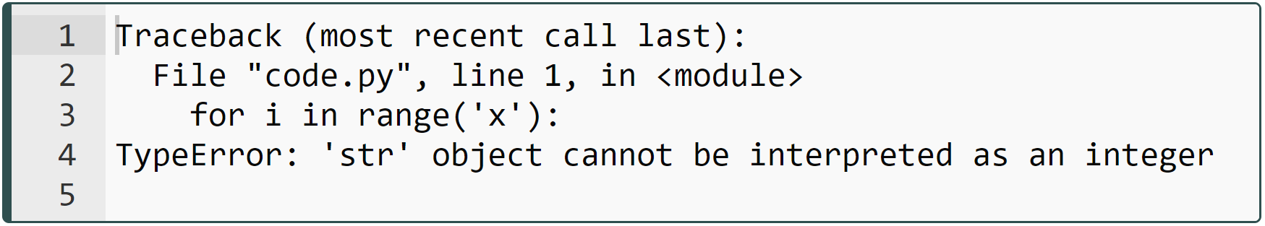
Common Exceptions (review)
TypeError
Notes:
As in the example; although it requires int, we have tried to iterate the wrong type - str - object in the range() function.
for i in range('x'):
print(i)

Slide 35
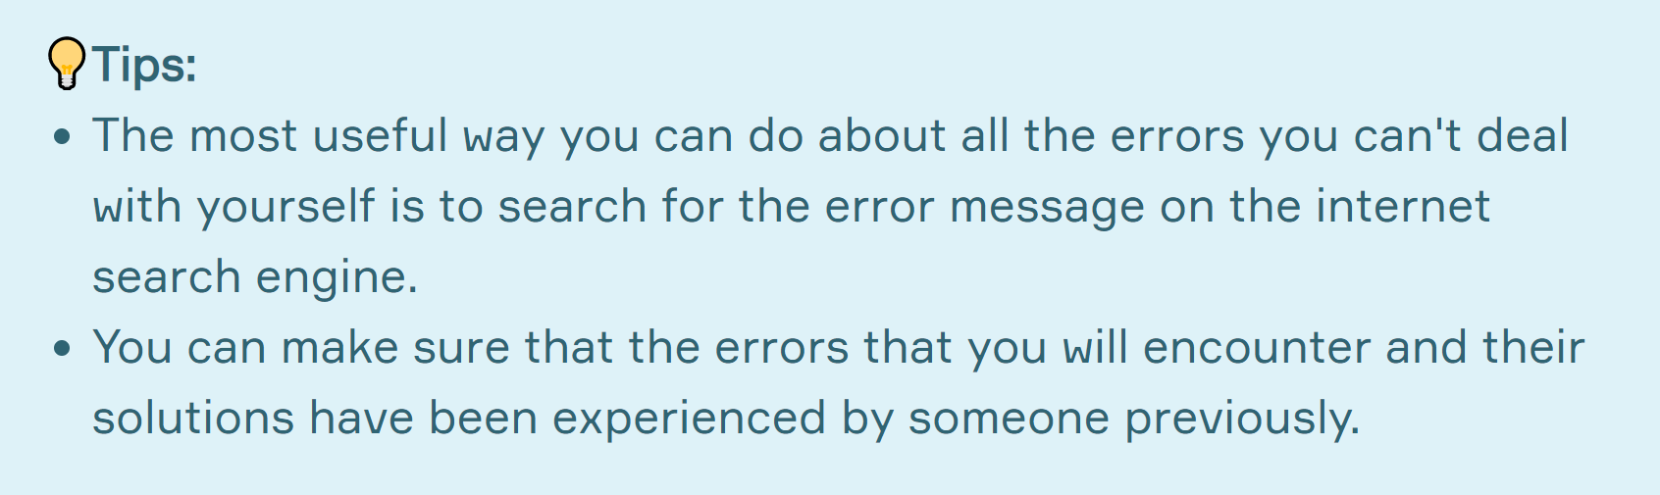
Common Exceptions (review)

Slide 36
Exception Handling
Notes:
yes what is exception handling. in this topic i would like to show you how to manage exceptions which may raise in a useful way. How can we better direct the exceptions that may arise to a good path.

Slide 37
Table of Contents
Introduction
Full 'Exception Handling Block'
Implementation of the Full 'Exception Handling Block'
Several Handling Scenarios
Notes:
at the end of this lesson you will be able to handle with exceptions using try except block.

Slide 38
Introduction
1

Slide 39
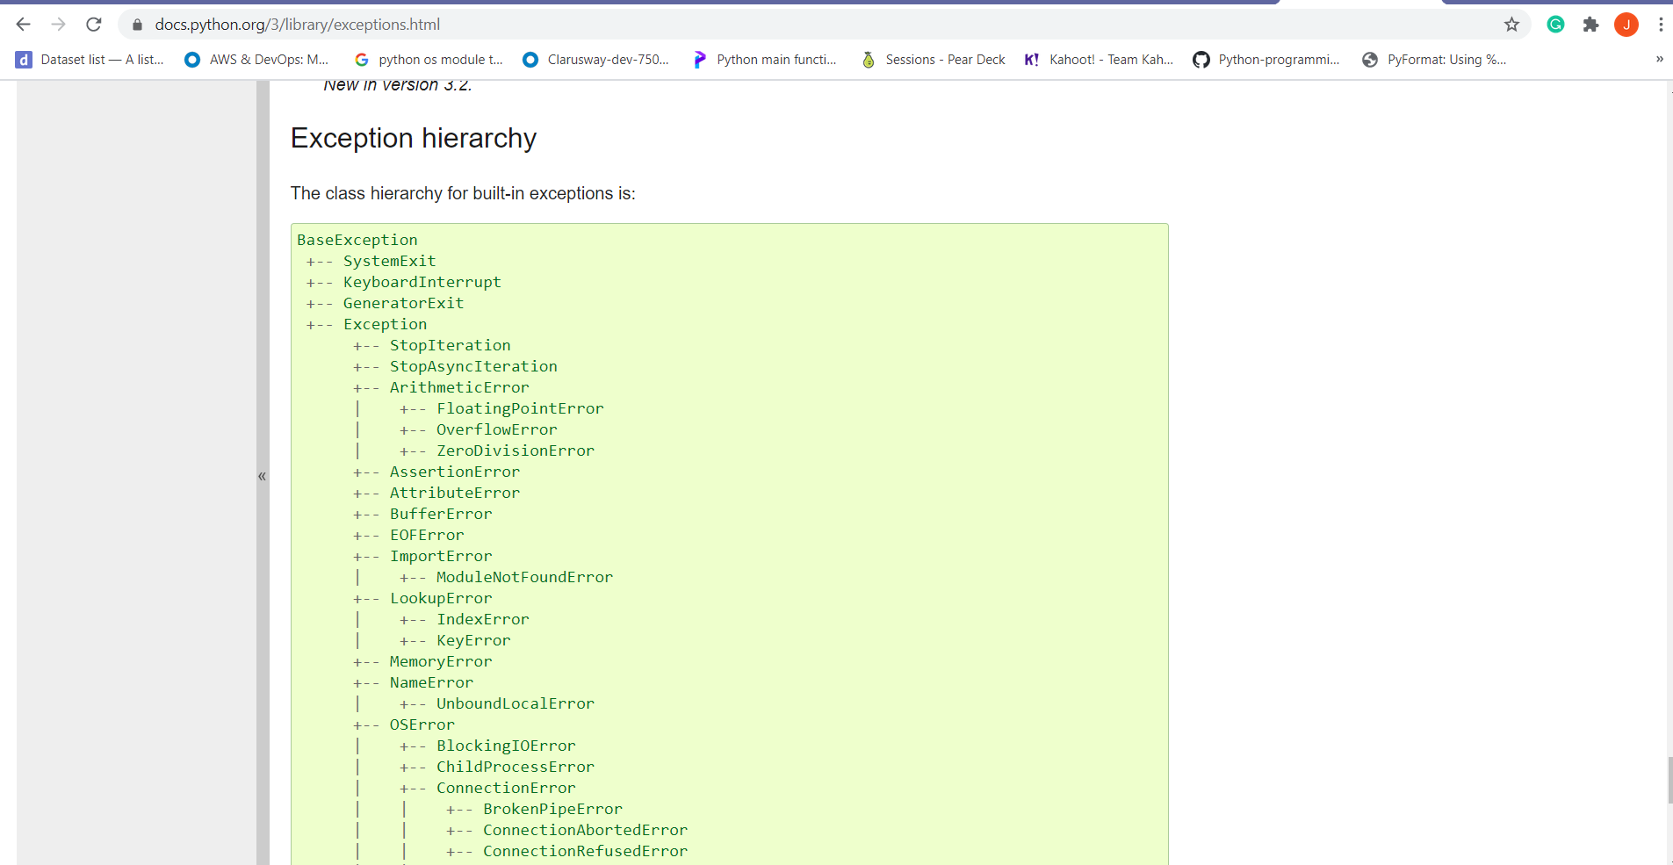
Introduction (review)
Notes:
ok. which one of you has visited this official python web page regarding exceptions.
In this lesson, you will learn the strategies we need to prevent exception errors from unnecessarily disrupting our program flow.
as time goes by, you will be getting familiar with these exception hierarchy
In some cases, you may need to anticipate exceptions that might disrupt your program flow and take action in advance.
This is where exception handling comes into play.
back

Slide 40
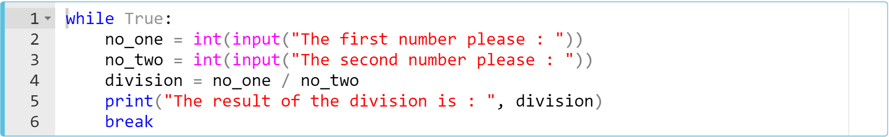
Introduction (review)
Example :
Notes:
For example, suppose we have a block of code that takes two numbers from the user, divides the first number by the second number and prints the output of the division.
while True:
no_one = int(input("The first number please : "))
no_two = int(input("The second number please : "))
division = no_one / no_two
print("The result of the division is : ", division)
break

Slide 41
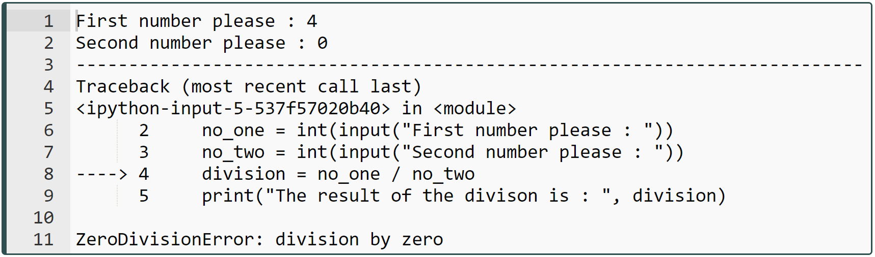

Introduction (review)
Let's see what happens if we input 4 and 0.
Notes:
of course it runs the program codes. starts from beginning and takes inputs from user and then boom. the zero division error exception raises. because we enter zero as divider. we cannot do that in normal mathematical operations. right?
while True:
no_one = int(input("The first number please : "))
no_two = int(input("The second number please : "))
division = no_one / no_two
print("The result of the division is : ", division)
break

Slide 42
Introduction (review)
The basic structure of try-except statement looks like :
try:
{
code block to be normally executed
except:
{
code block to be exceptionally executed
Notes:
Yes, we received an exception error message in our last attempt. So it's time to show you the way to solve it. We can ensure that our program continues without hesitation by using the try-except statement.

Slide 43
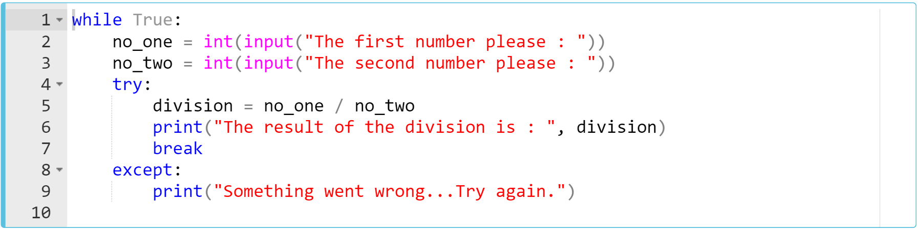
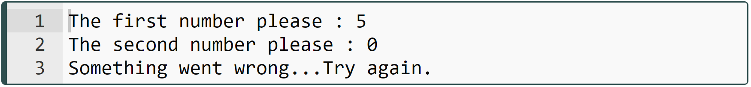
Introduction (review)
Let's fix this exception problem using try-except statement as follows and pass the numbers 5 and 0 :
executes except block
executes except block
Notes:
the while loop continues as long as there are exceptions
while True:
no_one = int(input("The first number please : "))
no_two = int(input("The second number please : "))
try:
division = no_one / no_two
print("The result of the division is : ", division)
break
except:
print("Something went wrong...Try again.")

Slide 44
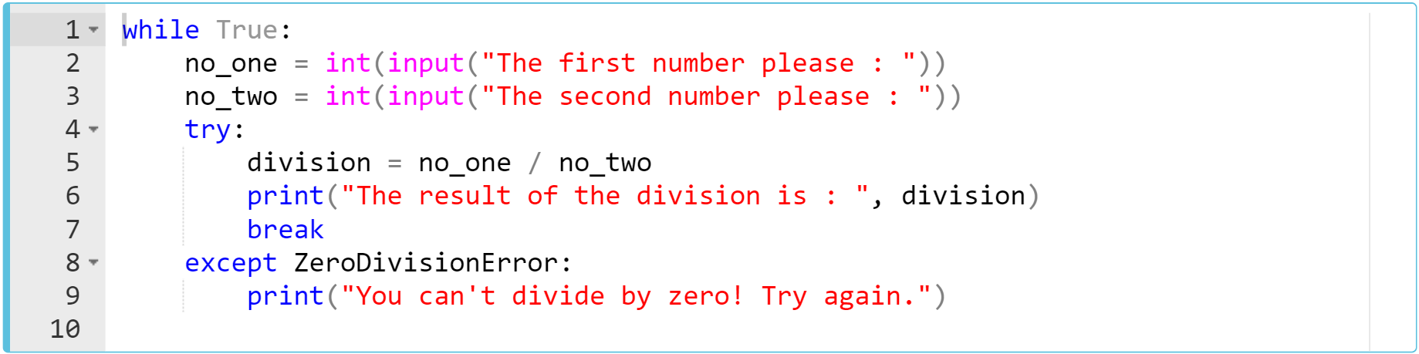
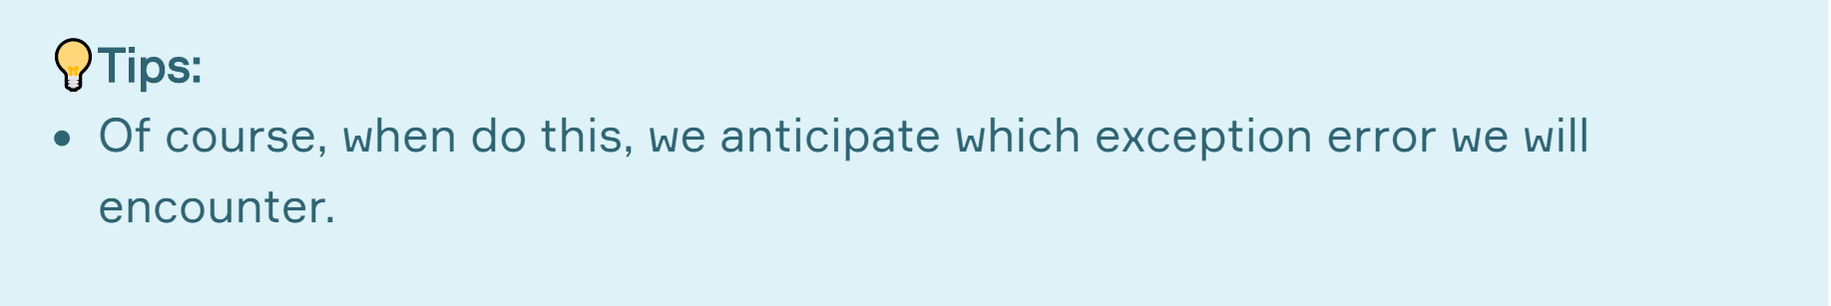
Introduction (review)
This time let’s specify the exception type which is ZeroDivisionError :
We specify the exception error
Notes:
in some cases, if we anticipate or know which exception can be raise, then we can specify the exception error.
while True:
no_one = int(input("The first number please : "))
no_two = int(input("The second number please : "))
try:
division = no_one / no_two
print("The result of the division is : ", division)
break
except ZeroDivisionError:
print("You can't divide by zero! Try again.")

Slide 45
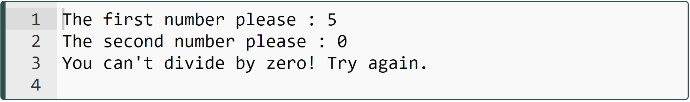
Introduction (review)
Let’s pass the same numbers 5 and 0.:
Notes:
.. and why we need to specify the error.? in some cases there might be several exception possibilities and we might handle with them using different code blocks for each. for example, if we need to deal with zero division error and type error in our same code block and if we wanna execute different codes when we encounter these exceptions. yes at this point we need to use this syntax similar to one on the screen. anyway i am gonna show you several examples about this usage at the last part of this lesson.
while True:
no_one = int(input("The first number please : "))
no_two = int(input("The second number please : "))
try:
division = no_one / no_two
print("The result of the division is : ", division)
break
except ZeroDivisionError:
print("You can't divide by zero! Try again.")

Slide 46
Exception Handling
Task :
Try to open a non-existing file named my_file.txt to read using try - except block,
Give the following message in case of exception raises:
"There is not such a file or the path is incorrect."
Notes:
try:
file = open("my_file.txt", "r")
print(file.read())
except:
print("There is not such a file or the path is incorrect")

Slide 47
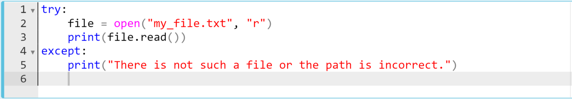
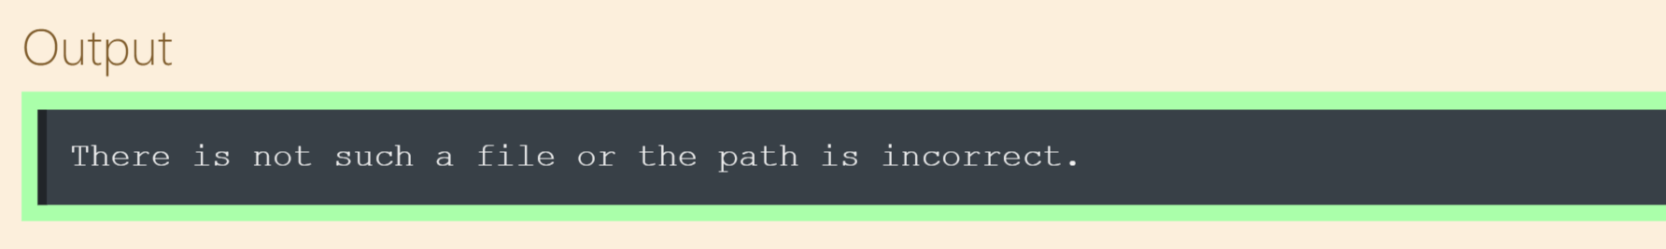
Exception Handling
The try - except code block can be as follows :
Notes:
try:
file = open("my_file.txt", "r")
print(file.read())
except:
print("There is not such a file or the path is incorrect")

Slide 48
Exception Handling
Task :
Try to open a non-existing file named my_file.txt to read using try - except block,
Specify the exception type for except block,
Give the following message in case of exception raises:
"There is not such a file or the path is incorrect."
Notes:
try:
file = open("my_file.txt", "r")
print(file.read())
except FileNotFoundError:
print("There is not such a file or the path is incorrect")

Slide 49
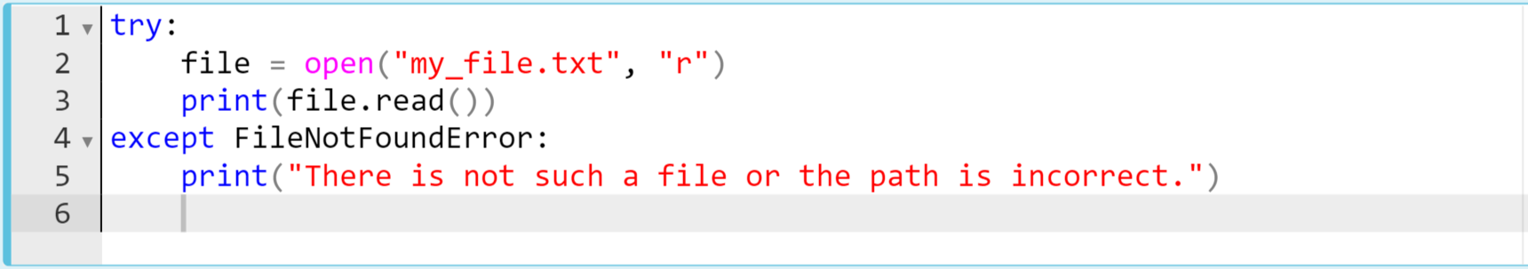
Exception Handling
The try - except code block can be as follows :
We specify the exception error
Notes:
try:
file = open("my_file.txt", "r")
print(file.read())
except FileNotFoundError:
print("There is not such a file or the path is incorrect")

Slide 50
Full 'Exception Handling Block'
2

Slide 51
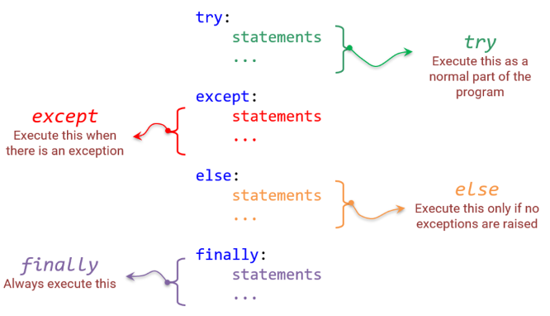
Full 'Exception Handling Block' (review)
The full version of try-except statement is as follows :
Notes:
…….
Let's make some explanations about the process :
First, Python executes all statements between try and except.
If there is no exception, then the try block is successfully executed and finished.
If an exception raises, the rest of the try block is ignored. After that, Python interpreter checks if the type of exception matches the exception specified after the except keyword, it executes the except block and resumes executing the program after the try-except block.
If an exception doesn’t match the exception named in the except syntax, it is known an unhandled exception and execution of your program stops with a traceback error message.
The else-block is only executed if there raised no exceptions.
We can use a finally syntax at the end of the block. A finally syntax is always executed before leaving the try-except block, whether an exception was raised or not.

Slide 52
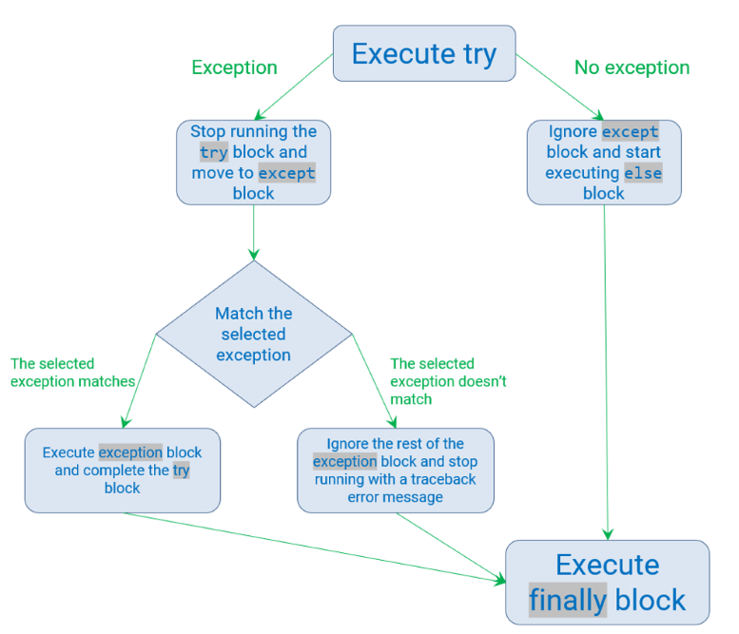
Full 'Exception Handling Block' (review)

Slide 53
Implementation of the Full 'Exception Handling Block'
3
Notes:
yes. you have learned the theoretical explanations and definitions and now it is time implement some cases. let’s use this block in our code.

Slide 54
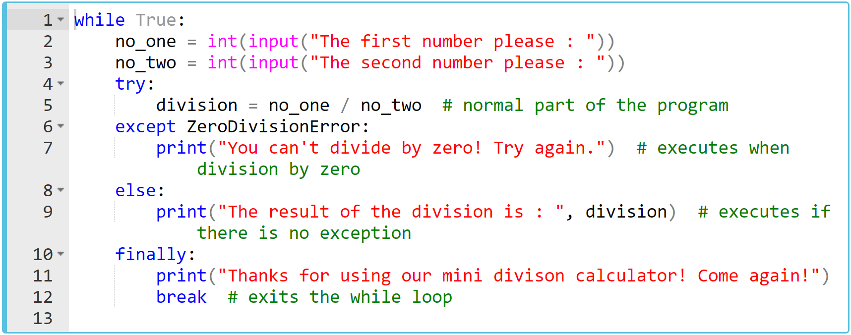
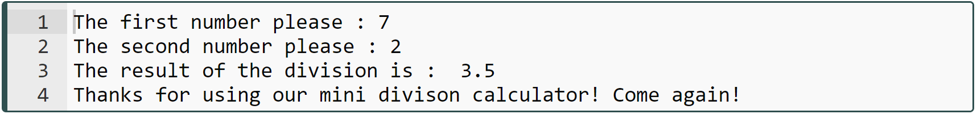
Implementation of the Full 'Exception Handling Block' (review)
Notes:
while True:
no_one = int(input("The first number please : "))
no_two = int(input("The second number please : "))
try:
division = no_one / no_two # normal part of the program
except ZeroDivisionError:
print("You can't divide by zero! Try again.") # executes when division by zero
else:
print("The result of the division is : ", division) # executes if there is no exception
finally:
print("Thanks for using our mini divison calculator! Come again!")
break # exits the while loop

Slide 55
Implementation of the Full 'Exception Handling Block' (review)
input ⇒ 7 and 0
Notes:
while True:
no_one = int(input("The first number please : "))
no_two = int(input("The second number please : "))
try:
division = no_one / no_two # normal part of the program
except ZeroDivisionError:
print("You can't divide by zero! Try again.") # executes when division by zero
else:
print("The result of the division is : ", division) # executes if there is no exception
finally:
print("Thanks for using our mini divison calculator! Come again!")
break # exits the while loop

Slide 56
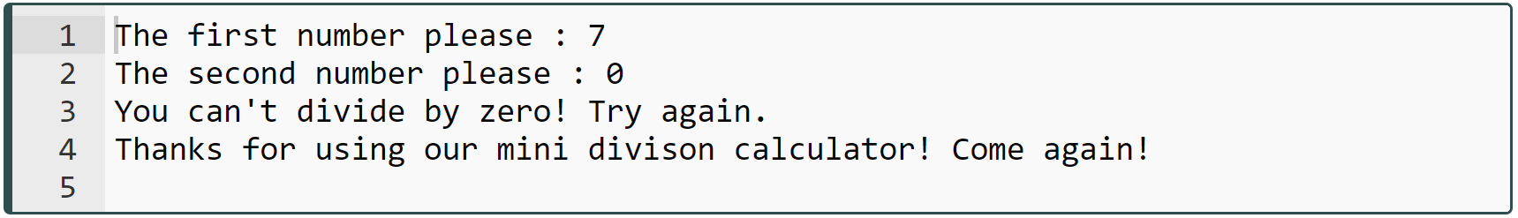
Implementation of the Full 'Exception Handling Block' (review)
Notes:
ok. let me ask a question to you. If we wanted to keep the loop going until a non-zero number was entered, what would we do? you should change the line of break keyword. in that case we need to get break keyword from finally and put into else
ok == jump ==
while True:
no_one = int(input("The first number please : "))
no_two = int(input("The second number please : "))
try:
division = no_one / no_two # normal part of the program
except ZeroDivisionError:
print("You can't divide by zero! Try again.") # executes when division by zero
else:
print("The result of the division is : ", division) # executes if there is no exception
finally:
print("Thanks for using our mini divison calculator! Come again!")
break # exits the while loop

Slide 57
Implementation of the Full 'Exception Handling Block' (review)
This time, let's enter str type as a second number. The selected exception (ZeroDivisionError) will not match, so traceback error will be raised.
input ⇒ 7 and "k"

Slide 58
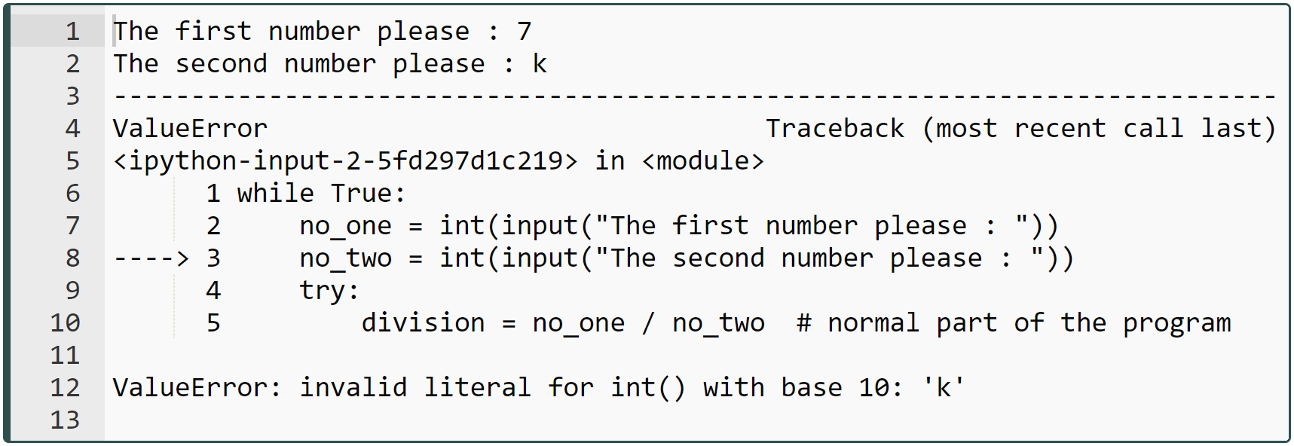
Implementation of the Full 'Exception Handling Block' (review)
Let’s see the result :
Notes:
yess. as you can see, if we cause another exception which we don't cover in our code, then it gives exception error message as usual

Slide 59
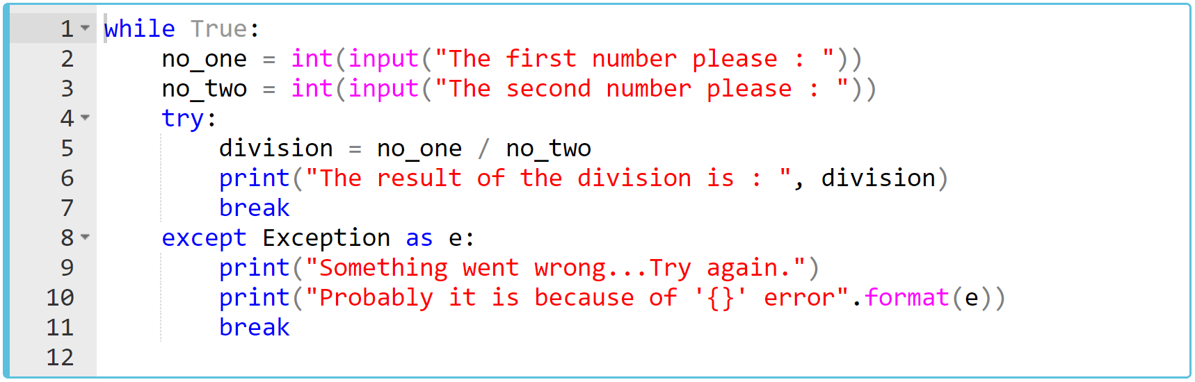
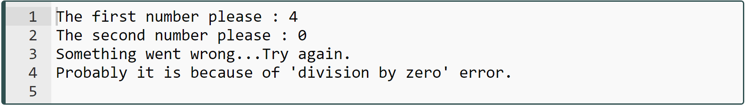
Implementation of the Full 'Exception Handling Block' (review)
Notes:
yes, as you can see the usage this keyword, we can get the exception error type by doing so. ….
while True:
no_one = int(input("The first number please : "))
no_two = int(input("The second number please : "))
try:
division = no_one / no_two
print("The result of the division is : ", division)
break
except Exception as e:
print("Something went wrong...Try again.")
print("Probably it is because of '{}' error".format(e))
break

Slide 60
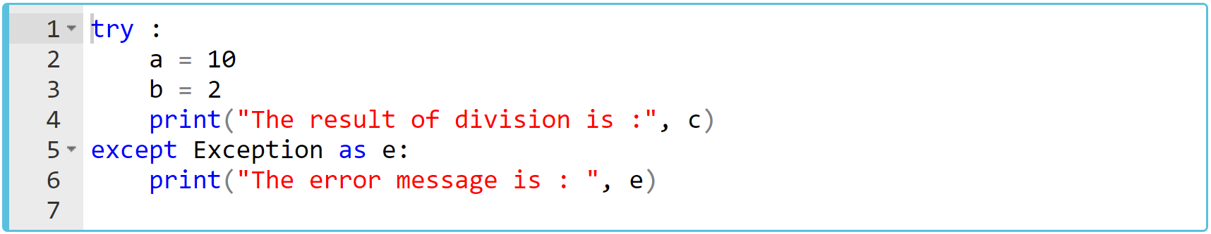
Implementation of the Full 'Exception Handling Block' (review)
Exception as
Notes:
try :
a = 10
b = 2
print("The result of division is :", c)
except Exception as e:
print("The error message is : ", e)

Slide 61
Implementation of the Full 'Exception Handling Block' (review)
else
else clause
Notes:
ok then. let me continue the exception blocks. it is time to learn else clause. The try…except block has an optional else clause. The else clause is executed only if no exceptions are raised.

Slide 62
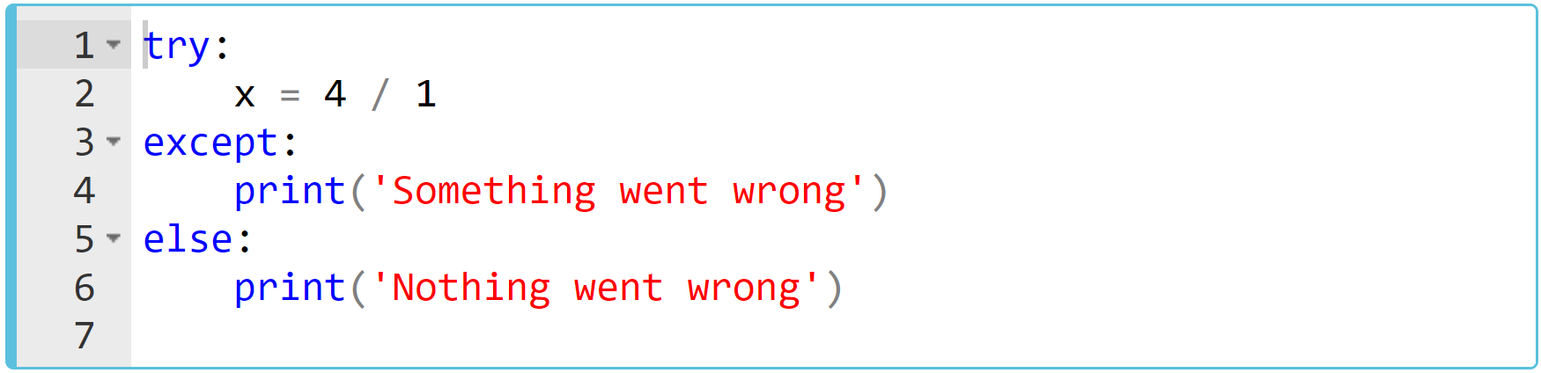
Implementation of the Full 'Exception Handling Block' (review)
Let’s see the result :
else clause executes, because there is no exception
Notes:
try:
x = 4 / 1
except:
print('Something went wrong')
else:
print('Nothing went wrong')

Slide 63
Implementation of the Full 'Exception Handling Block' (review)
finally
finally clause
Notes:
The try…except block has another optional finally clause. The finally clause is always executed, whether an exception has occurred or not.

Slide 64
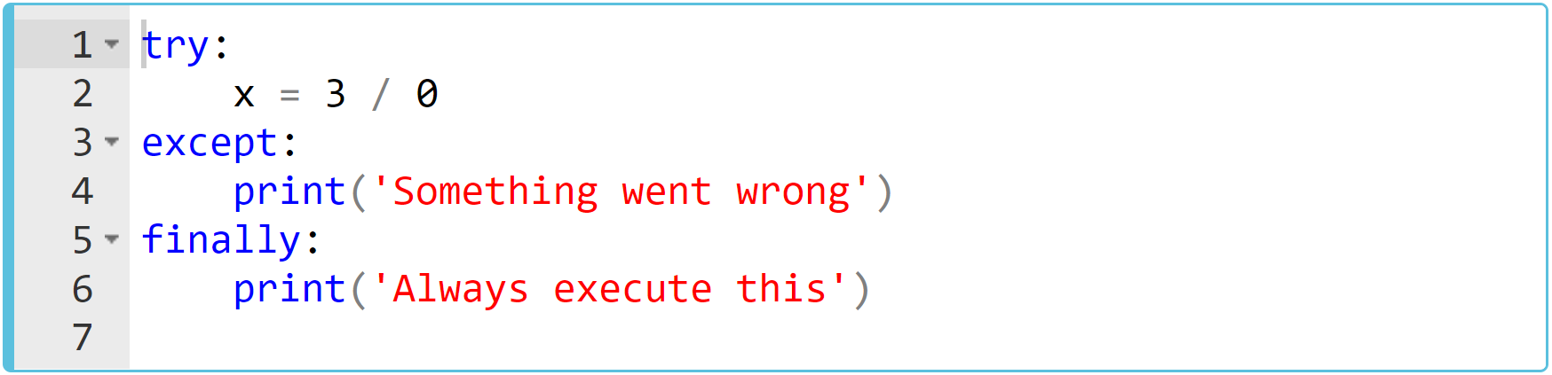
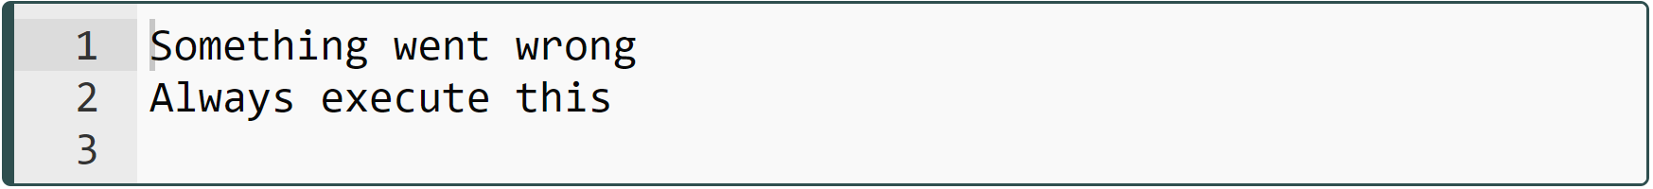
Implementation of the Full 'Exception Handling Block' (review)
Let’s see the result :
Although there is an ZeroDivisionError exception, finally block executes
comes from except
comes from finally
Notes:
try:
x = 3 / 0
except:
print('Something went wrong')
finally:
print('Always execute this')

Slide 65
Several Handling Scenarios
4
Notes:
ok. starting from this part of our lesson, we are gonna implement several exception handling scenarios

Slide 66
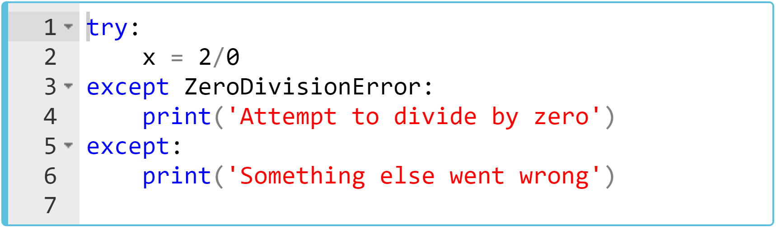
Several Handling Scenarios (review)
In the example below you can define as many except blocks as you want, to catch and handle specific exceptions :
What is the output? Try to figure out in your mind...
Notes:
try:
x = 2/0
except ZeroDivisionError:
print('Attempt to divide by zero')
except:
print('Something else went wrong')

Slide 67
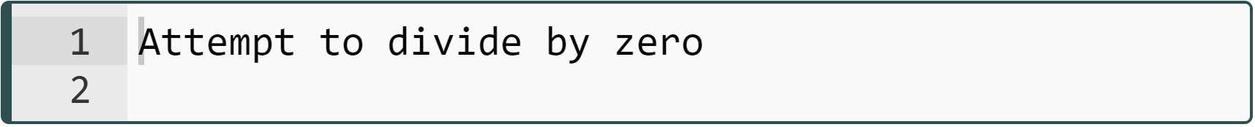
Several Handling Scenarios (review)
Here is the output :
first exception possibility
rest of all exception possibilities
Notes:
try:
x = 2/0
except ZeroDivisionError:
print('Attempt to divide by zero')
except:
print('Something else went wrong')

Slide 68

Several Handling Scenarios (review)
Since all the built-in exceptions are formed a hierarchical structure, you can use the following exception syntaxes.
scenario-1: you can identify no specific exception :
scenario-2: different exception blocks one after another :
Notes:
....
except:
print("Unknown exception error occured. Tyr again please.")
....
except ZeroDivisionError:
print("You can't divide by zero!!")
except ValueError:
print("You can only enter numbers consisting of digits, not text!!")

Slide 69


Several Handling Scenarios (review)
scenario-3: an except syntax also may contain multiple exceptions separated by commas and enclosed by parenthesis.
scenario-4: because of the hierarchical structure, one exception can actually catch various exceptions.
Notes:
== you jump to first slide to show hierarchical structure of exceptions ==
....
except (ValueError, TypeError):
print("You can only enter numbers consisting of digits, not text!!")
....
except ArithmeticError:
print("I will also catch OverflowError, FloatingPointError and ZeroDivisionError")

Slide 70
Exception Handling
Task :
Using while loop and try … except block,
To select the favorite fruit from the given fruits list, write a program that requests an index number from the user and prints the selected fruit on the screen (eg: "My favorite fruit is mango").
Considering the possible exceptions caused by the user’s entry, display warning messages, and continue to ask for an index number from the user until valid input is taken.
fruits = ["banana", "mango", "pear", "apple", "kiwi", "grape"]
Notes:
fruits = ["banana", "mango", "pear", "apple", "kiwi", "grape"]
while True:
try:
index = int(input("Pick an index number to choose your favorite fruit"))
print("My favorite fruit is", fruits[index])
break
except IndexError:
print("There is no such an index. Try again!")
except ValueError:
print("You should enter integer. Try again!")

Slide 71

Exception Handling
The code snippet can be as follows :
Notes:
fruits = ["banana", "mango", "pear", "apple", "kiwi", "grape"]
while True:
try:
index = int(input("Pick an index number to choose your favorite fruit"))
print("My favorite fruit is", fruits[index])
break
except IndexError:
print("There is no such an index. Try again!")
except ValueError:
print("You should enter integer. Try again!")

Slide 72
Exception Handling
Task :
Using while loop and full try … except block,
At this time, in addition to the previous program,
Give the user three chances to enter an input, and whenever the user raises an exception, decrease the counter by 1 displaying that "<warning message>, you have n right left. Try again!"
If no exception raise, display a message : "Congrats! You've entered a valid input."
In all circumstances, display a message : "Our fruits are always fresh!"
My favorite fruit is mango
Congrats! You've entered a valid input.
Our fruits are always fresh!
example
input ⇒ 1, output ⇒
Notes:
fruits = ["banana", "mango", "pear", "apple", "kiwi", "grape"]
count = 3
while count > 0:
try:
index = int(input("Pick an index number to choose your favorite fruit"))
print("My favorite fruit is", fruits[index])
except IndexError:
count -= 1
print("There is no such an index. You have {count} right left. Try again!")
except ValueError:
print("You should enter integer. You have {count} right left. Try again!")
else:
print("Congrats! You've entered a valid input.")
break
finally:
print("Our fruits are always fresh!")

Slide 73

Exception Handling
The code snippet can be as follows :
Notes:
fruits = ["banana", "mango", "pear", "apple", "kiwi", "grape"]
count = 3
while count > 0:
try:
index = int(input("Pick an index number to choose your favorite fruit"))
print("My favorite fruit is", fruits[index])
except IndexError:
count -= 1
print("There is no such an index. You have {count} right left. Try again!")
except ValueError:
print("You should enter integer. You have {count} right left. Try again!")
else:
print("Congrats! You've entered a valid input.")
break
finally:
print("Our fruits are always fresh!")

